Slide 1
Cassandra and Modelling Basics
SELECT * FROM presenters WHERE name = ‘Hayato Shimizu’;
name | title | company | area
----------------+--------------------------+----------+------
Hayato Shimizu | Solutions Architect Lead | DataStax | EMEA

Slide 2
Apache Cassandra
Created by Avinash Lakshman and Prashant Malik at Facebook
Cassandra is:
A distributed database
Highly scalable
Fault tolerant
High throughput
Network topology aware
Multi-DC Active-Active
Written in Java
Cassandra is not:
ACID compliant database
A relational database
ANSI SQL compliant
A document database

Slide 3
DataStax and Cassandra
Founded in 2010 by Jonathan Ellis and Matt Pfeil
80% Apache Cassandra code contribution
Offer commercial support for DataStax Enterprise version of Cassandra
DataStax Enterprise integrates Search and Analytics
Head Quarter in San Francisco Bay area
EMEA office opened in March 2013

Slide 4
Cassandra Basics

Slide 5
Replication Factor and Data Consistency In a Distributed System
CAP – Consistency, Availability,
Partition Tolerance
Consistency is achieved with W + R > N
Quorum = N / 2 + 1

Slide 6
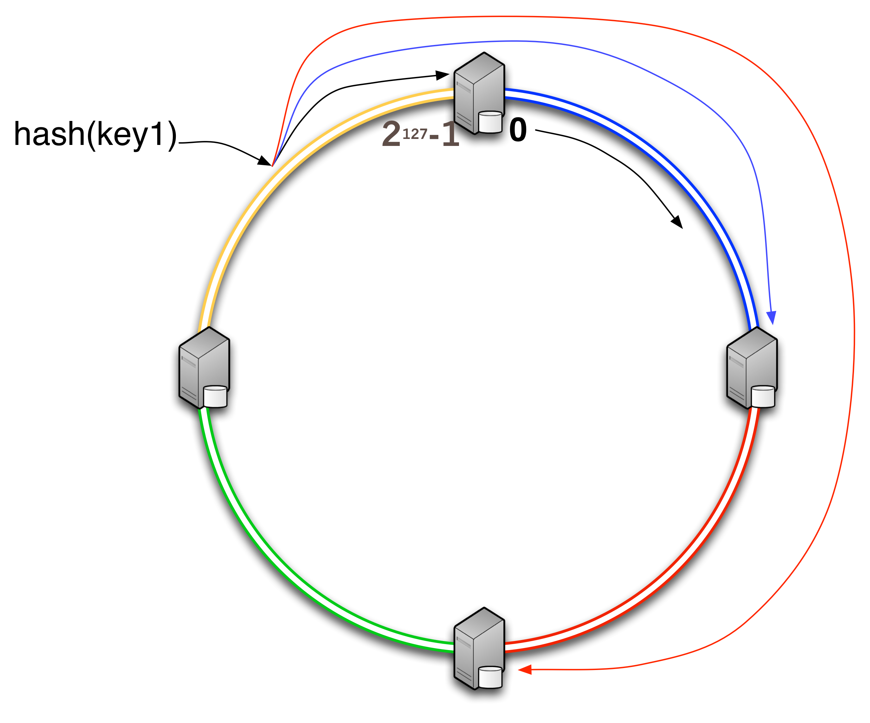
Cassandra Replication Strategy
Token Range 0 -> 2¹²⁷-1 in Ring Formation
Consistent Hashing Algorithm
Replica nodes in clockwise
Gossip protocol between nodes

Slide 7
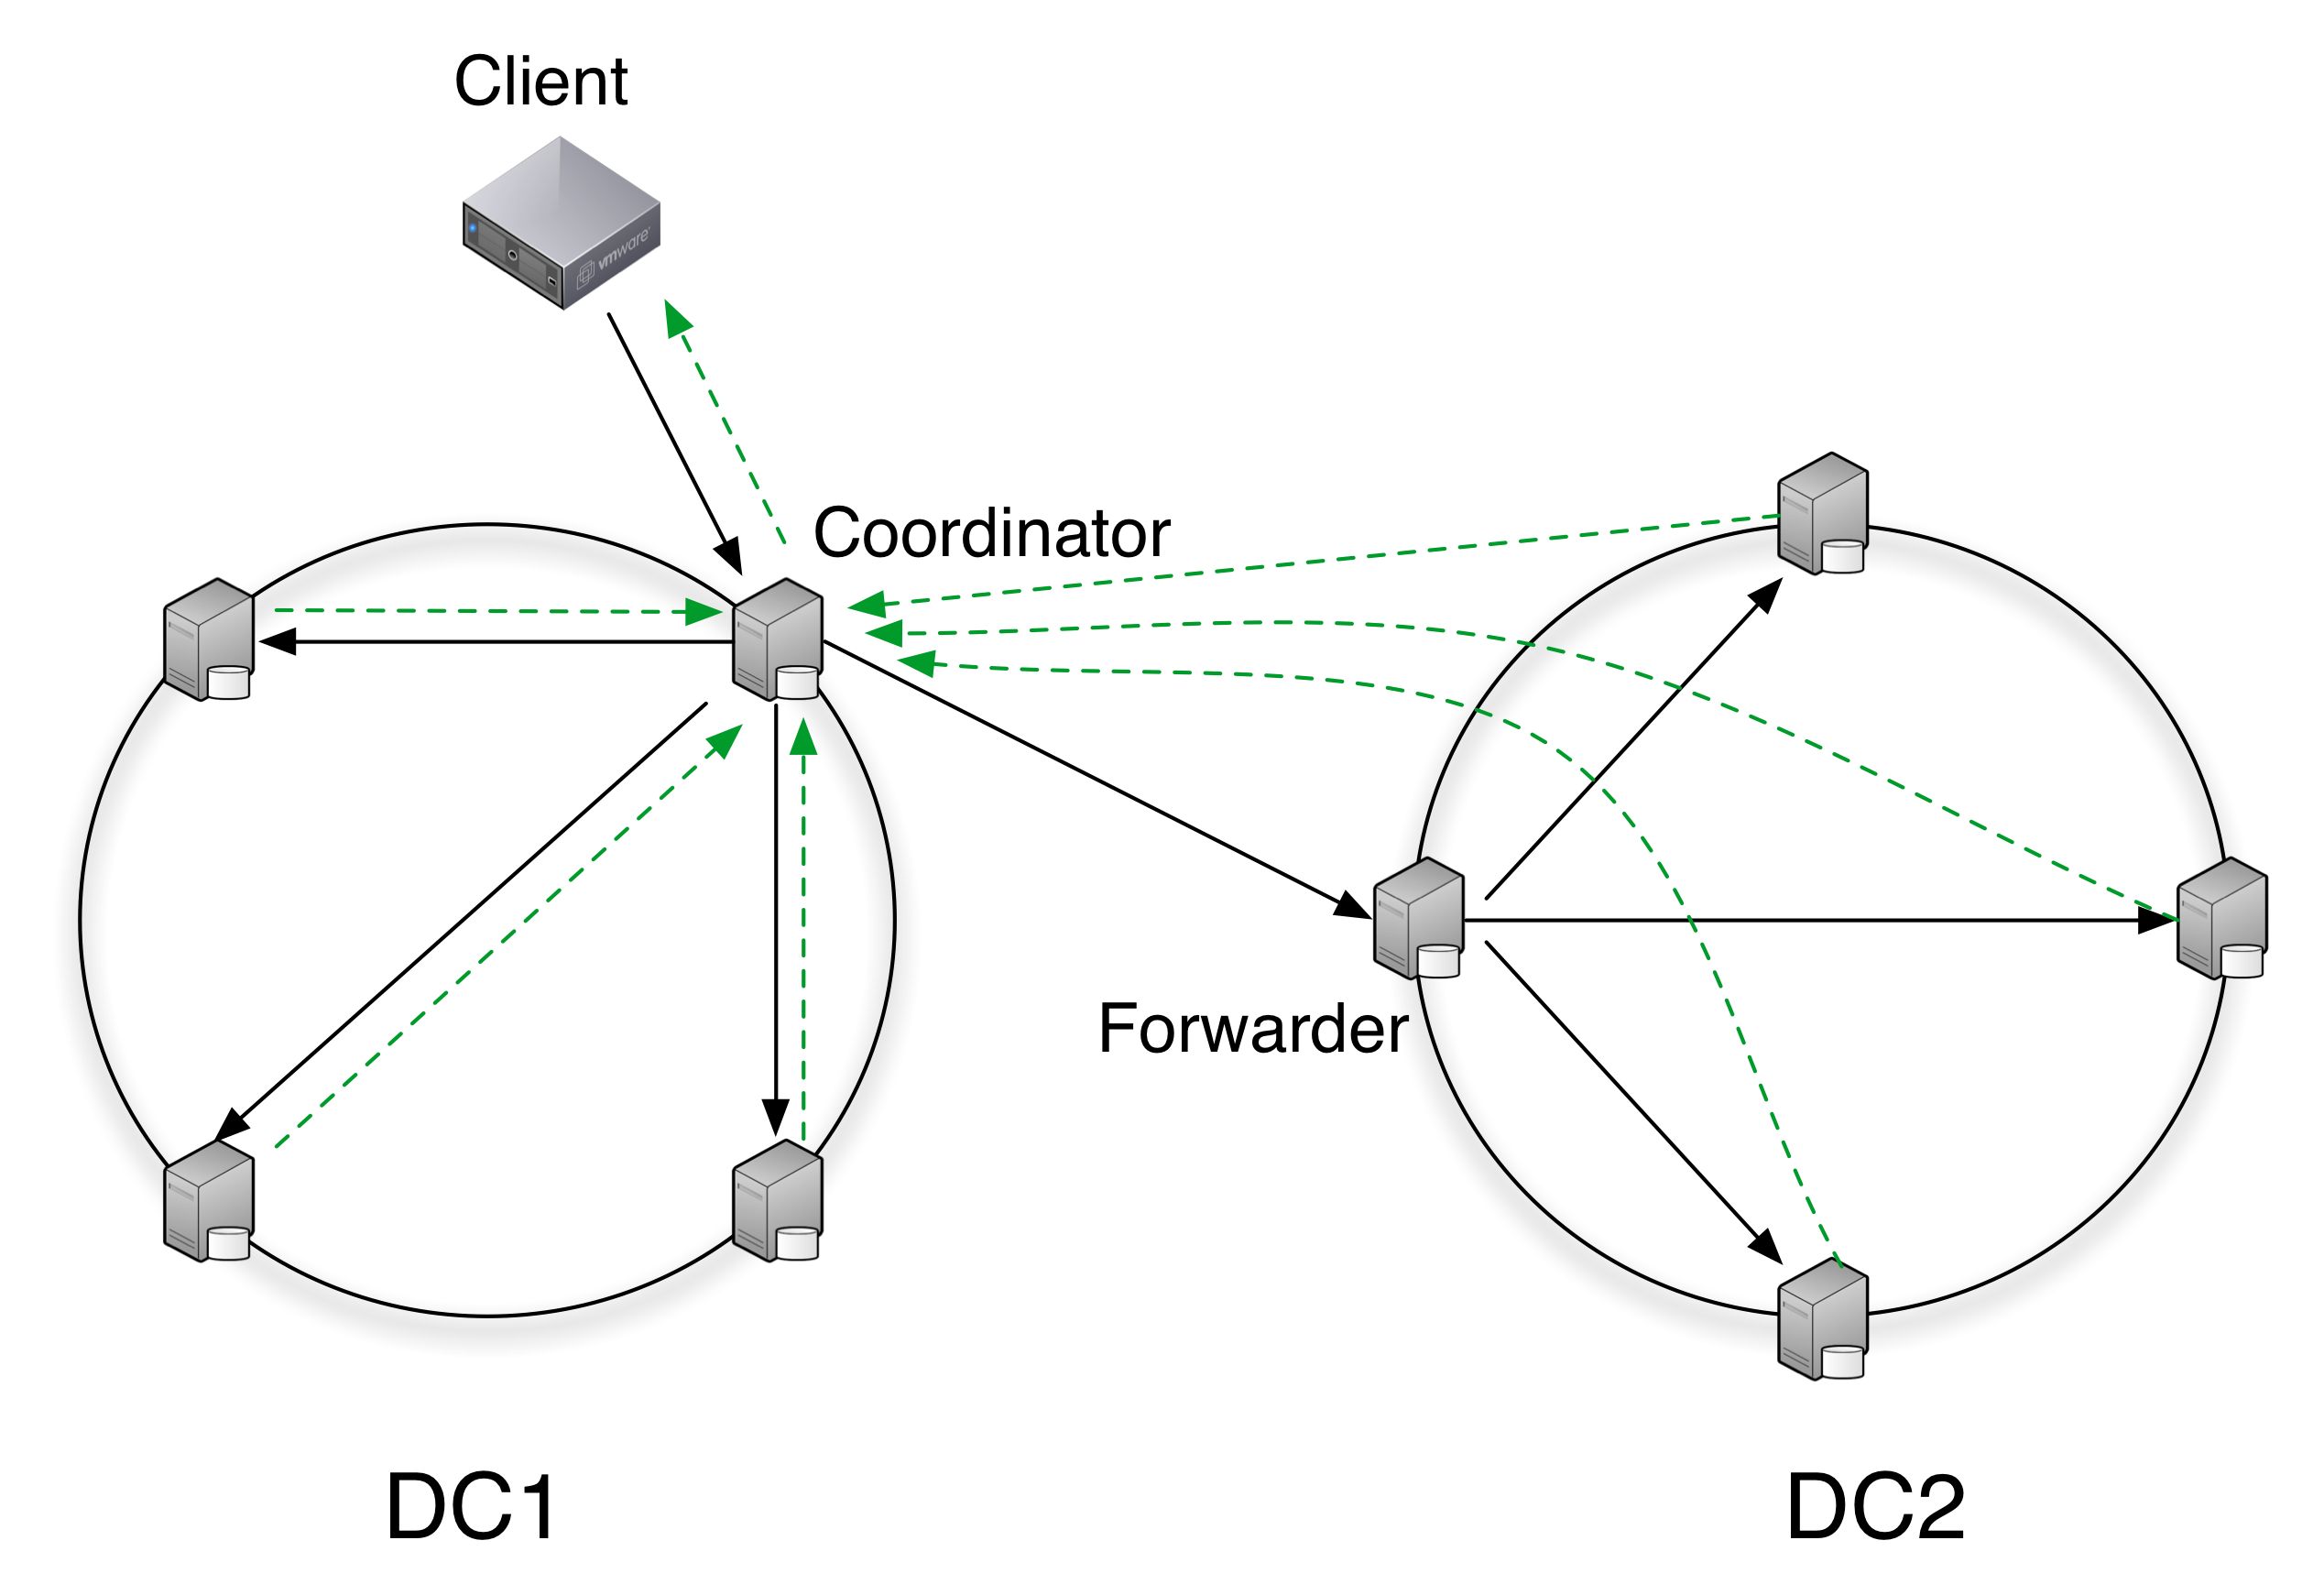
Network Topology Awareness
Writes
Reads
Any
One
Quorum
Local_Quorum
Each_Quorum
All
One
Quorum
Local_Quorum
Each_Quorum
All

Slide 8
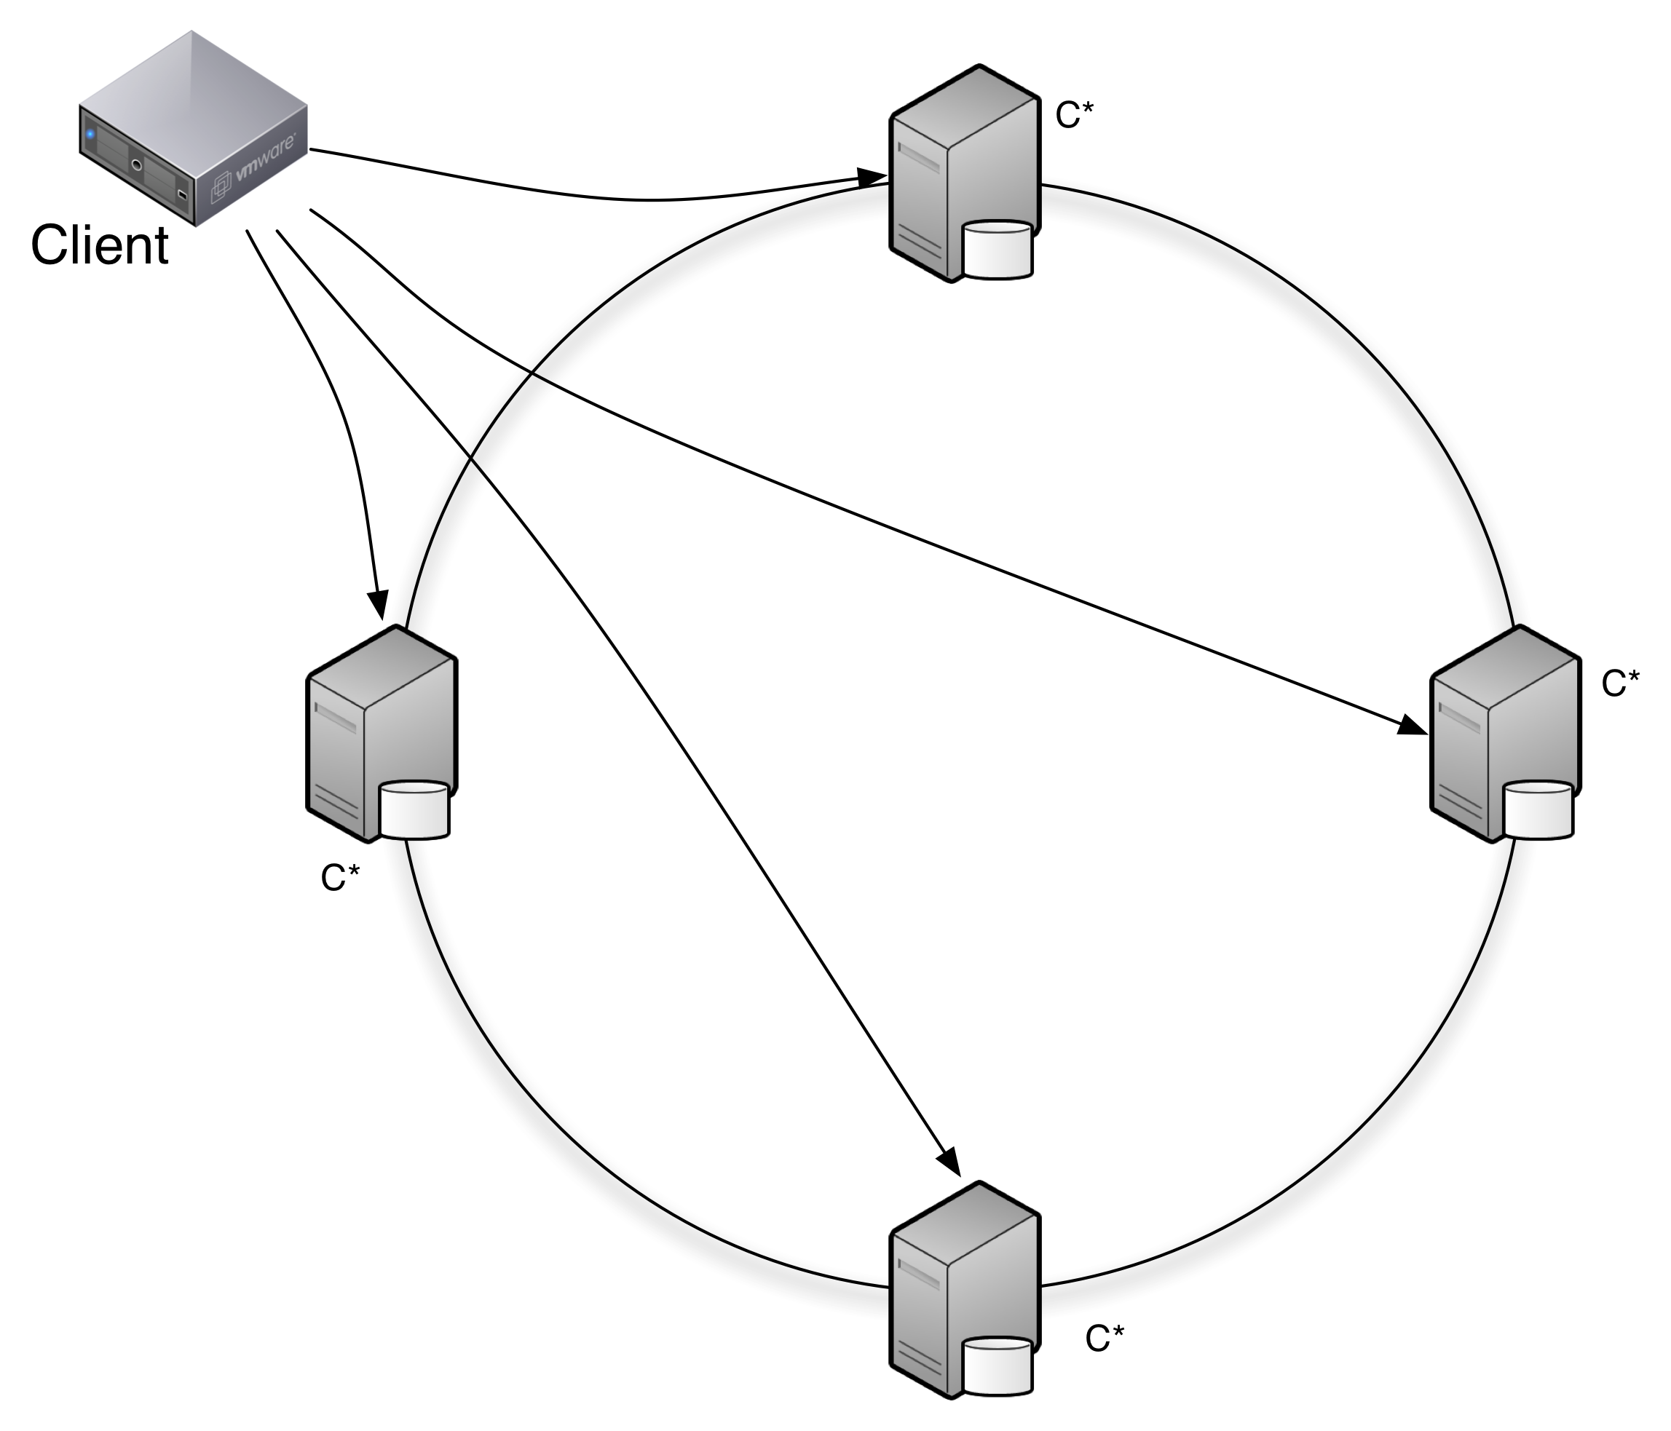
No Single Point of Failure
Client Load Balances
Do not use a hardware LB

Slide 9
Logical Grouping

Slide 10
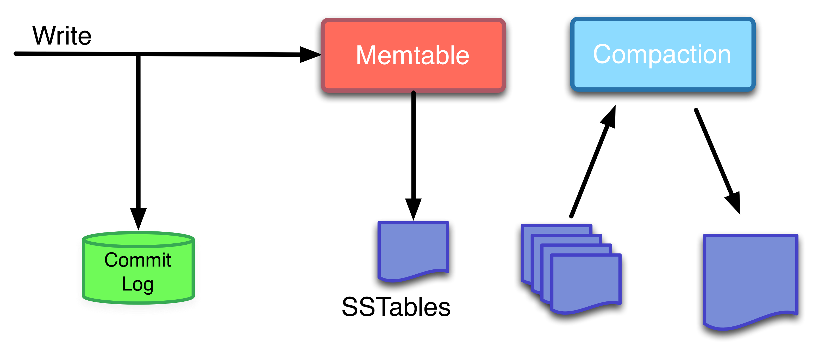
Write Path

Slide 11
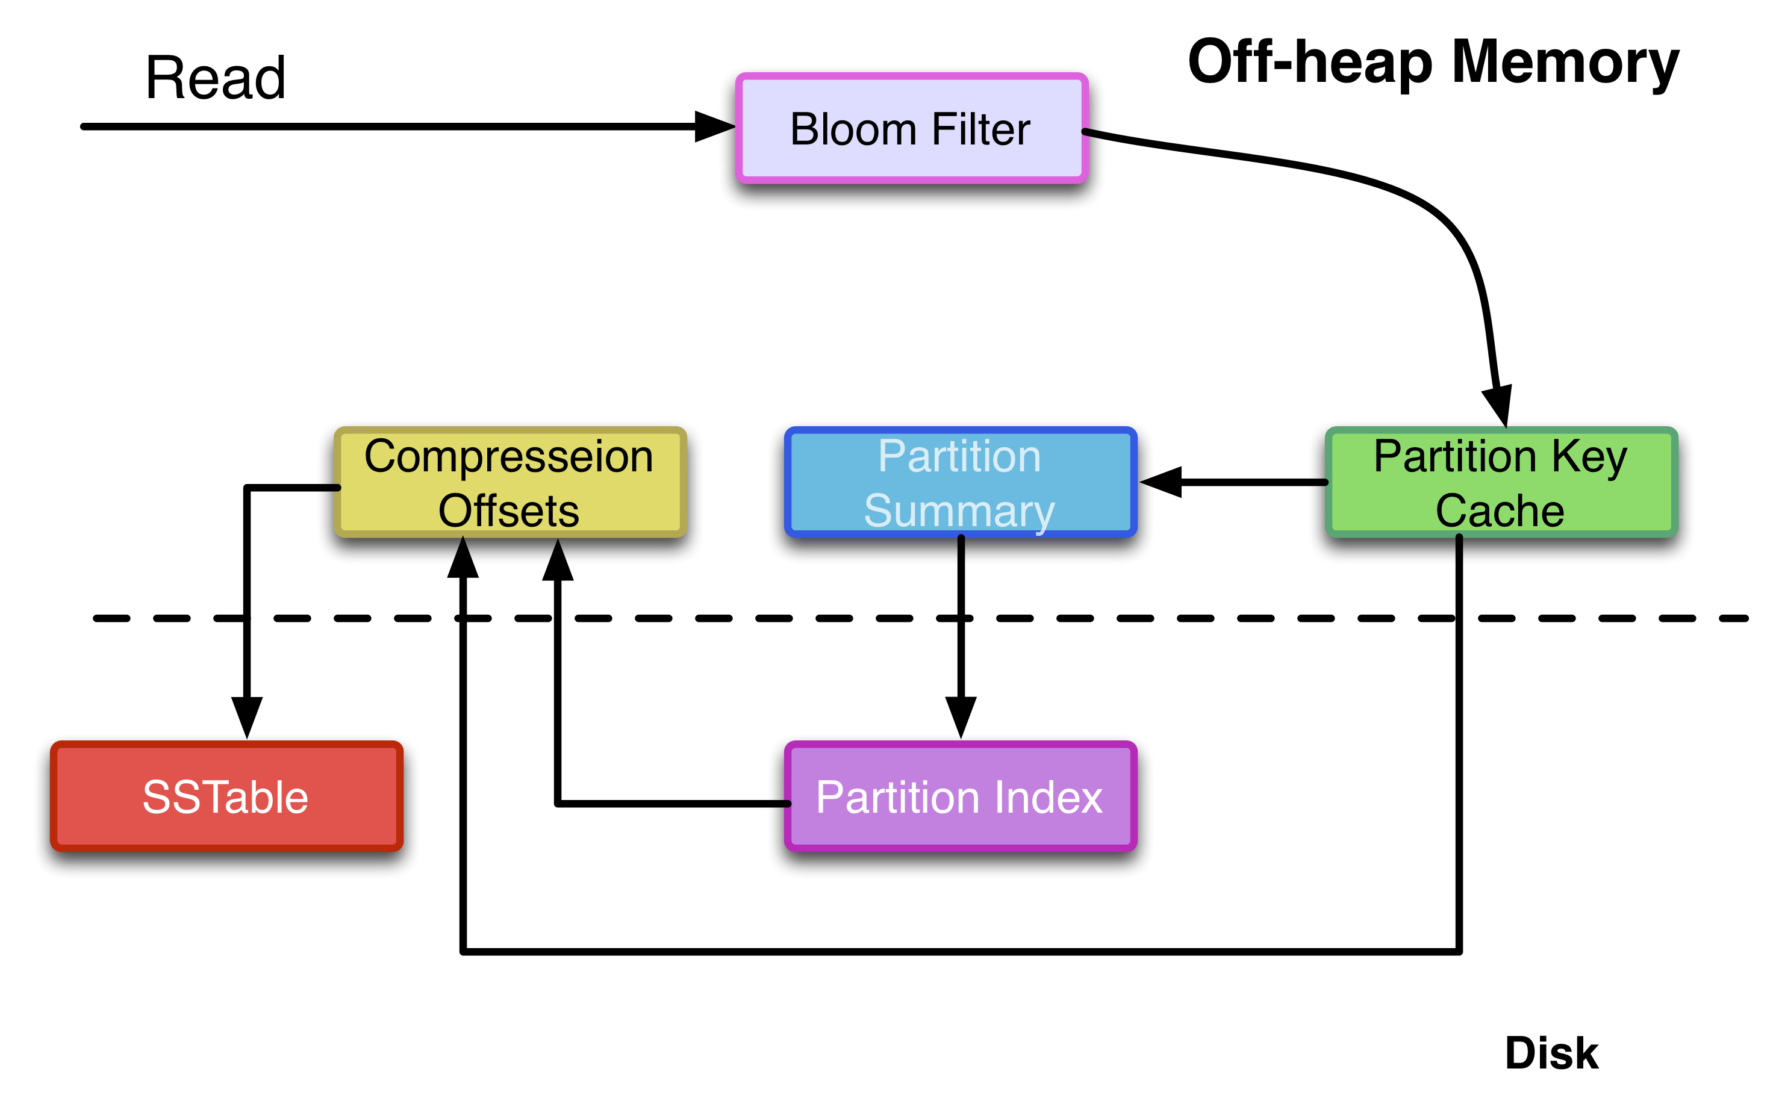
Read Path

Slide 12
CQL3

Slide 13
Why CQL3?
Excellent language for modelling data structures
Usability
Readability
Familiarity
Programming language agnostic

Slide 14
Apache Thrift, Hector, Astyanax days
Column col = new Column(ByteBuffer.wrap("product".getBytes())));
col.setValue(ByteBuffer.wrap("phone".getBytes());
col.setTimestamp(System.currentTimeMillis());
ColumnOrSuperColumn c = new ColumnOrSuperColumn();
c.setColumn(col);
Mutation m = new Mutation();
m.setColumn_or_supercolumn(c);
List<Mutations> ms = new ArrayList<Mutation>();
ms.add(m);
Map<String, List<Mutations>> cf = new HashMap<String, List<Mutations>>();
cf.put("products", m);
Map<ByteBuffer, Map<String, List<Mutation>>> records = new HashMap<ByteBuffer, Map<String, List<Mutation>>>();
records.put(ByteBuffer.wrap("key".getBytes()), cf);
client.batch_mutate(records, consistencyLevel);

Slide 15
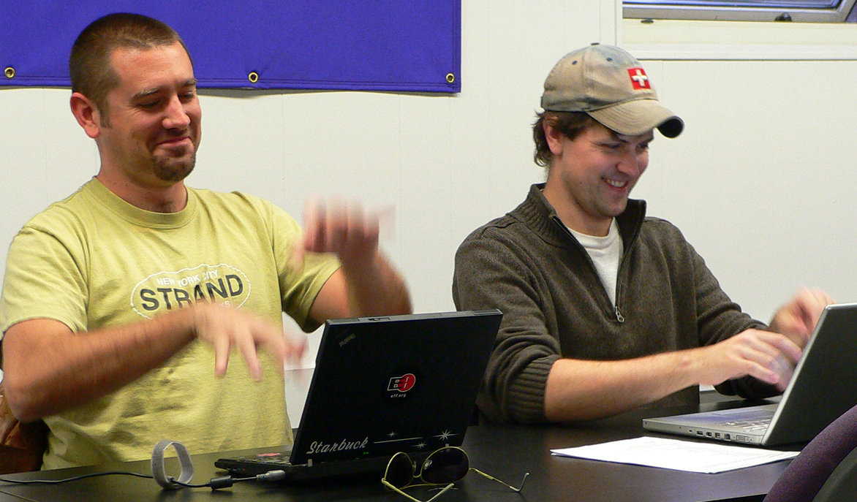
CQL3
INSERT INTO products (product_id, product)
VALUES (“id12321”, “phone”);

Slide 16
CQL Basics – creating a table
CREATE TABLE cities (
city_name varchar,
elevation int,
population int,
latitude float,
longitude float,
PRIMARY KEY (city_name)
);
We can visualize it this way:
city_name is the partition key
In this example, the partition key = primary key

Slide 17
CQL Basics – Composite Primary Key
The Primary Key
The key uniquely identifies a row.
A composite primary key consists of:
A partition key
One or more clustering columns
e.g. PRIMARY KEY (partition key, cluster columns, ...)
The partition key determines on which node the partition resides
Data is ordered in cluster column order within the partition

Slide 18
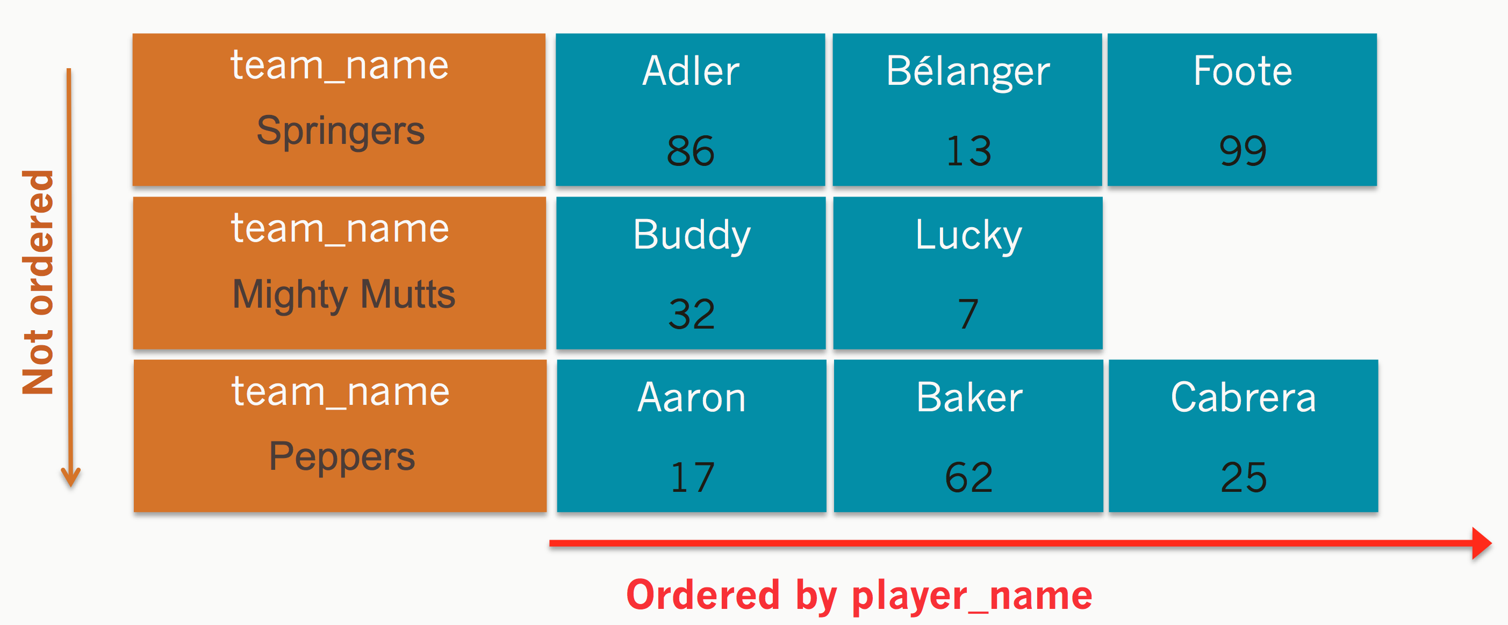
CQL Basics – Composite Primary Key
CREATE TABLE sporty_league (
team_name varchar,
player_name varchar,
jersey int,
PRIMARY KEY (team_name, player_name)
);

Slide 19
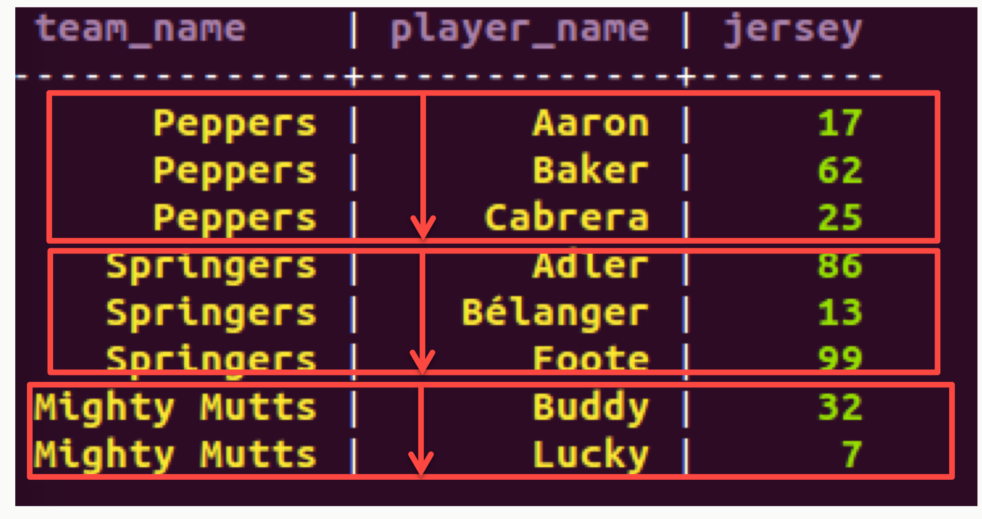
CQL Basics – Simple Select
SELECT * FROM sporty_league;
More than a few rows can be slow. (Limited to 10,000 rows by default)
Use LIMIT keyword to choose fewer or more rows

Slide 20
CQL Basics - Simple Select on Partition Key and Cluster Columns
SELECT * FROM sporty_league WHERE team_name = ‘Mighty Mutts’;
SELECT * FROM sporty_league WHERE team_name = ‘Mighty Mutts’ and player_name = ‘Lucky’;

Slide 21
CQL Basics – Insert/Update
INSERT INTO sporty_league (team_name, player_name, jersey) VALUES ('Mighty Mutts',’Felix’,90);

Slide 22
CQL Basics - Ordering
Partition keys are not ordered, but the cluster columns are.
However, you can only order by a column if it’s a cluster column.
Data will returned by default in the order of the clustering column.
You can also use the ORDER BY keyword – but only on the clustering column!
SELECT * FROM sporty_league WHERE team_name = ‘Mighty Mutts’ ORDER BY player_name DESC;

Slide 23
CQL Basics – Composite Partition Key
CREATE TABLE cities (
city_name varchar,
state varchar, elevation float, latitude float, longitude float
population float,
PRIMARY KEY ((city_name,state))
);
Each city gets it own partition!

Slide 24
CQL Basics – Performance considerations
The best queries are in a single partition. i.e. WHERE partition key = <something>
Queries that span multiple partitions are s-l-o-w
Queries that span multiple cluster columns are fast

Slide 25
CQL Basics - Tracing
You can turn on tracing on or off for queries with the TRACING ON | OFF command.
This can help you understand what Cassandra is doing and identify any performance problems.
http://www.datastax.com/dev/blog/tracing-in-cassandra-1-2

Slide 26
CQL Basics – TTL
Expiring Columns, or Time to Live (TTL)
INSERT INTO users (id, first, last) VALUES (‘abc123’, ‘abe’, ‘lincoln’) USING TTL 3600;
// Expires data in one hour

Slide 27
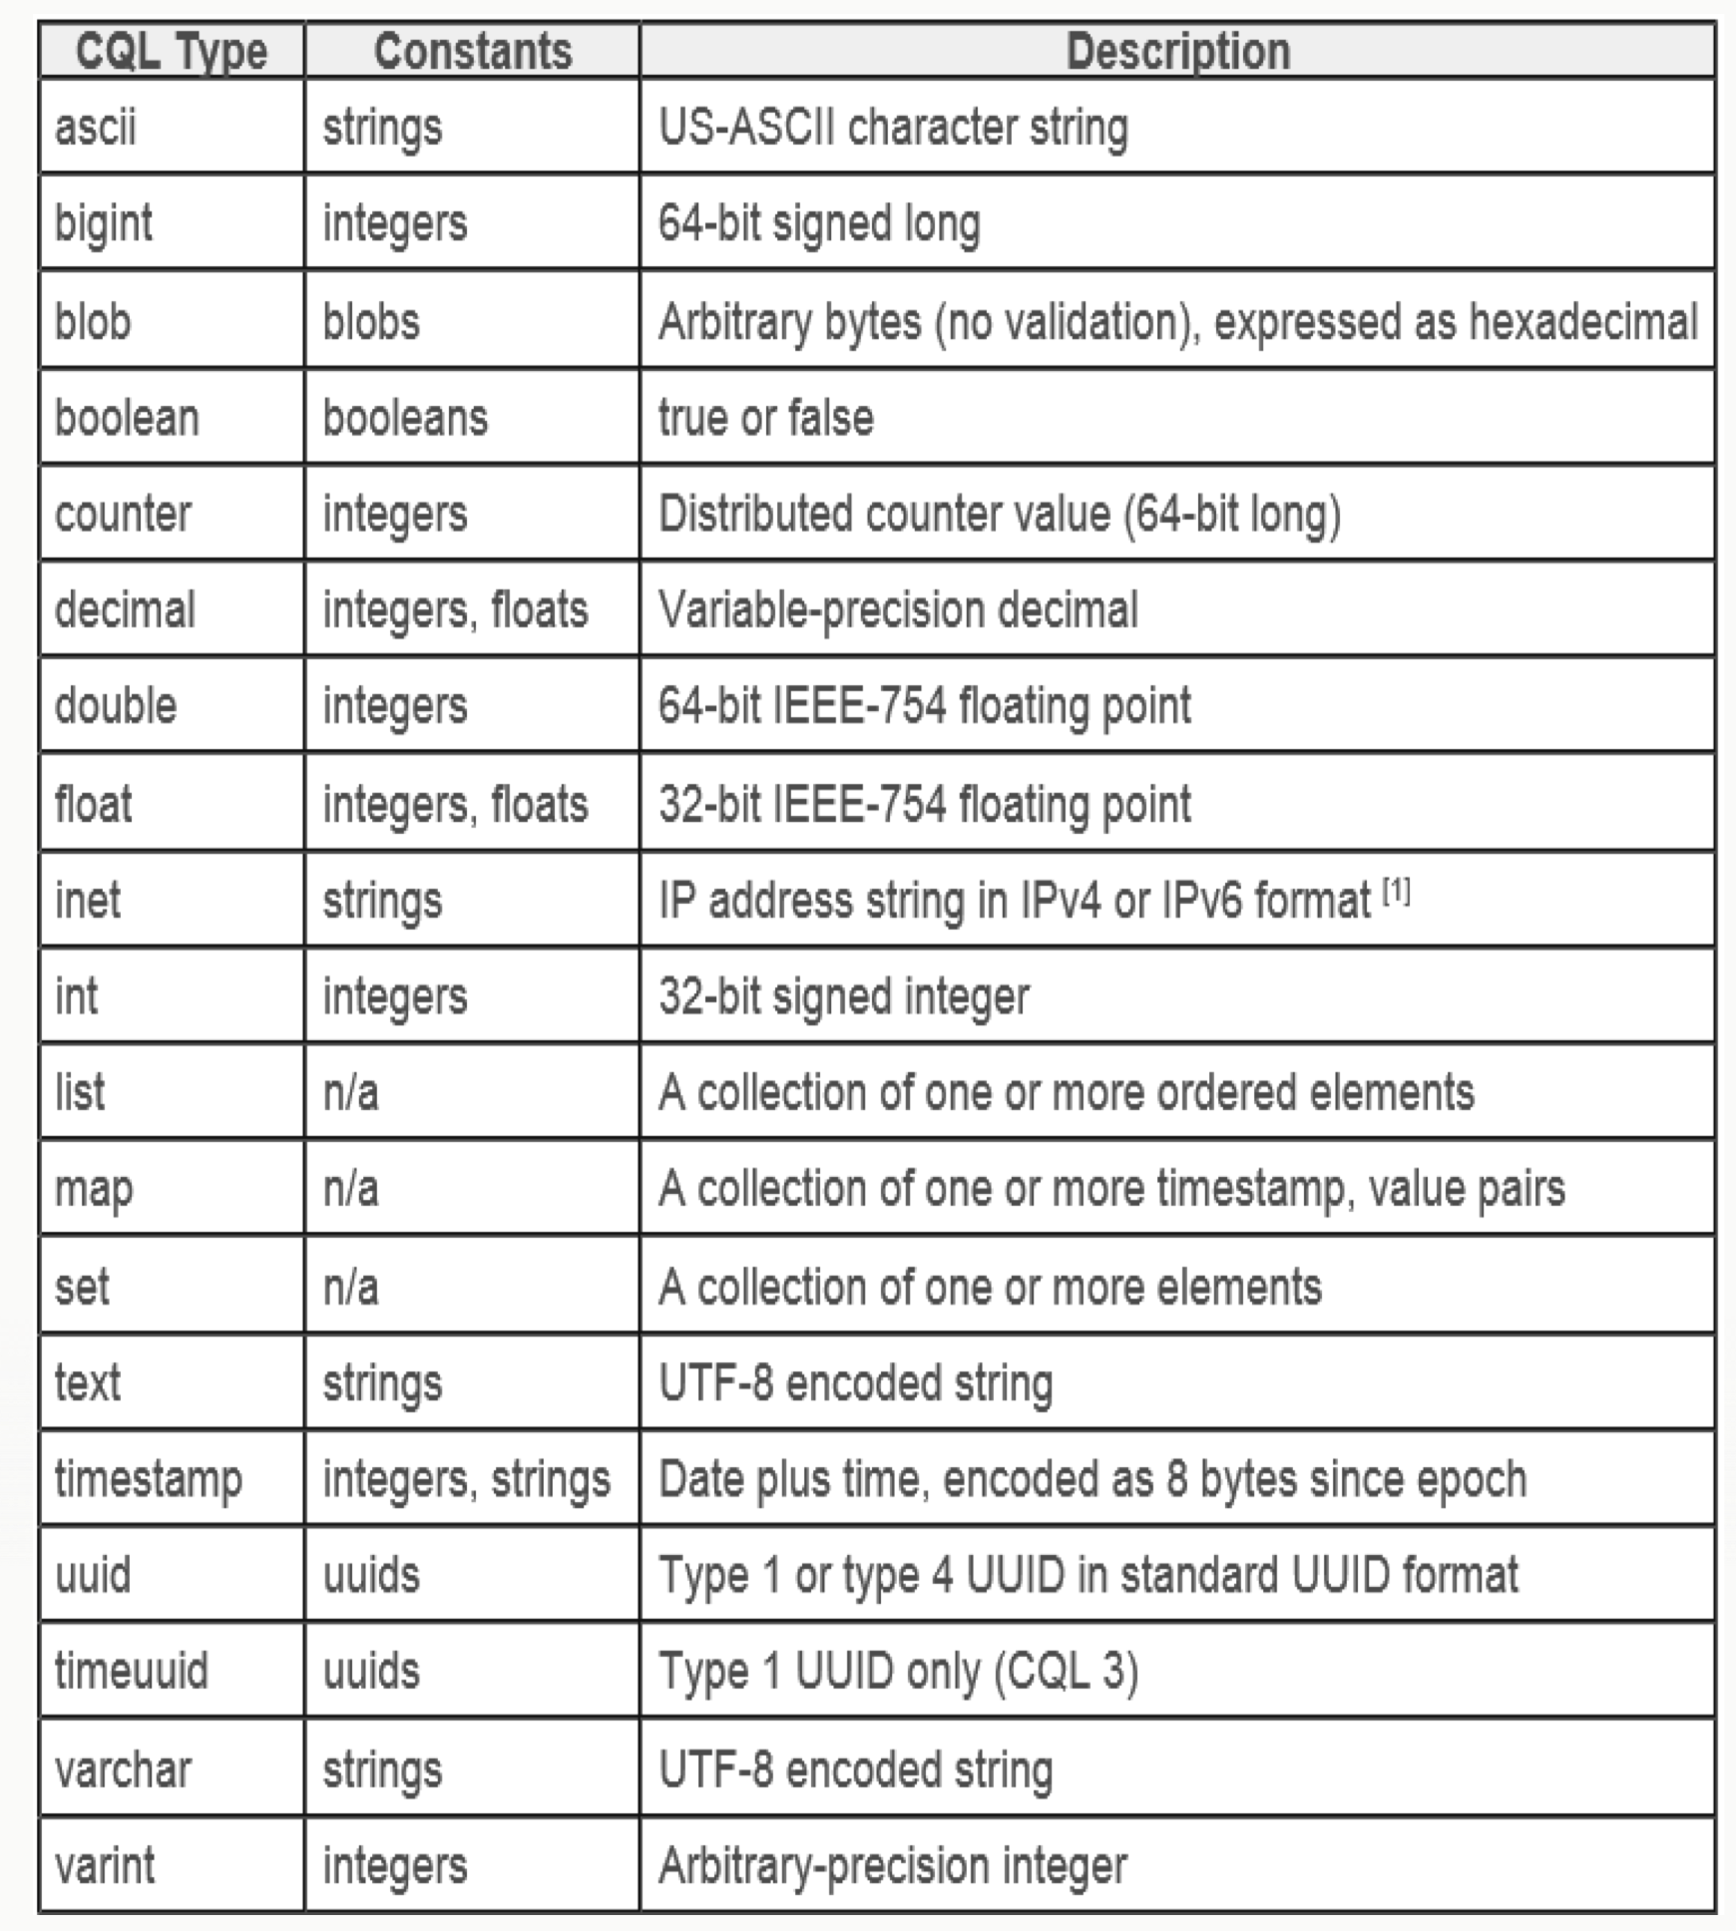
CQL Basics – Data Types

Slide 28
CQL Basics – Data Types: Collections
CQL supports having columns that contain collections of data.
The collection types include:
Set, List and Map.
These data types are intended to support the type of 1-to-many relationships that can be modeled in a relational DB e.g. a user has many email addresses.
Some performance considerations around collections.
Often more efficient to denormalise further rather than use collections if intending to store lots of data.
Favour sets over list – lists not very performant
CREATE TABLE collections_example (
id int PRIMARY KEY,
set_example set<text>,
list_example list<text>,
map_example map<int, text>
);

Slide 29
Data Modelling

Slide 30
Time Series
CREATE TABLE sensor_data (
sensor_id int,
date varchar,
time timeuuid,
value int,
PRIMARY KEY ( (sensor_id, date), time)
) WITH CLUSTERING ORDER BY (time DESC);
INSERT INTO sensor_data
(sensor_id, date, time, value)
VALUES (
1, '20130908',
c8d91860-1883-11e3-8ffd-0800200c9a66,
432
) USING TTL 604800;
SELECT time, value, TTL (value) FROM sensor_data
WHERE sensor_id = 1 AND date = '20130908'
AND time > maxTimeuuid('2013-09-08 10:05+0000')
AND time < minTimeuuid('2013-09-08 15:00+0000’);
time | value | ttl(value)
--------------------------------------+-------+------------
c8d91860-1883-11e3-8ffd-0800200c9a66 | 432 | 604257
df9bad29-1887-11e3-8ffd-0800200c9a66 | 433 | 604452

Slide 31
Time Series
SELECT * FROM sensor_data WHERE sensor_id = 1 AND date = ‘20130908’;
sensor_id | date | time | value
-----------+----------+--------------------------------------+-------
1 | 20130908 | df9bad29-1887-11e3-8ffd-0800200c9a66 | 432
1 | 20130908 | c8d91860-1883-11e3-8ffd-0800200c9a66 | 433
list sensor_data;
-------------------
RowKey: 1:20130908
=> (name=df9bad29-1887-11e3-8ffd-0800200c9a66:, value=, timestamp=1378596760172000, ttl=604800)
=> (name=df9bad29-1887-11e3-8ffd-0800200c9a66:value, value=000001b0, timestamp=1378596760172000, ttl=604800)
=> (name=c8d91860-1883-11e3-8ffd-0800200c9a66:, value=, timestamp=1378596408527000, ttl=604800)
=> (name=c8d91860-1883-11e3-8ffd-0800200c9a66:value, value=000001b1, timestamp=1378596408527000, ttl=604800)

Slide 32
Don’t do this
Oracle 11G Doc: Index maintenance can present a significant CPU and I/O resource demand in any write-intensive application.
CREATE TABLE users (
id uuid PRIMARY KEY,
username text,
email text,
street_address text,
town text,
);
CREATE INDEX user_street ON users (street_address);
CREATE INDEX user_town ON users (town);
SELECT * FROM users WHERE
town = ‘Stockholm’ AND
street_address = ‘Sankt Eriksgatan’
ALLOW FILTERING;

Slide 33
Instead Do This
CREATE TABLE users (
id uuid PRIMARY KEY,
username text,
email text,
street_address text,
town text,
);
CREATE TABLE user_street (
town text,
street text,
user_id uuid,
PRIMARY KEY ((town, street), user_id)
);

Slide 34
Native Protocol / DataStax Drivers
CQL3 Only
Fully asynchronous protocol, using Netty
Server notifications
Optional compression
Java, C#, and Python so far, more will be added
Many policies, including TokenAwarePolicy, DowngradeConsistencyRetryPolicy, LoadBalancingPolicy, DCAwareRoundRobinPolicy etc
<dependency>
<groupId>com.datastax.cassandra</groupId>
<artifactId>cassandra-driver-core</artifactId>
<version>1.0.5</version>
</dependency>

Slide 35
CQL Basics - Lightweight Transactions
Introduced in Cassandra 2.0
Example:
INSERT INTO customer_account (customerID, customer_email) VALUES (‘LauraS’, ‘lauras@gmail.com’) IF NOT EXISTS;
UPDATE customer_account SET customer_email=’laurass@gmail.com’ IF customer_email=’lauras@gmail.com’;
Great for 1% of your application – but not recommended to be used too much!
Eventual consistency is your friend:
http://www.slideshare.net/planetcassandra/c-summit-2013-eventual-consistency- hopeful-consistency-by-christos-kalantzis

Slide 36
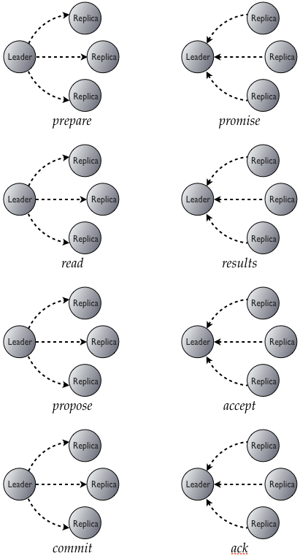
Lightweight Transaction –PAXOS based
All operations are quorum-based
An elected leader prepares the participating replicas a ballot
Replicas would reply with the promise
Each replica sends information about unfinished operations to the leader during prepare
Paxos Made Simple
Paxos Made Live – An Engineering Perspective

Slide 37
That’s it for today!
Now go build your cool applications!

Slide 38
Q&A

